Slide 1
E-HELP DESK:AN ONLINE APPROACH
Under the supervision of
Dr C. Raghavendra
Associate Professor
Group Members : Y. Siddharth Reddy (19B81A3348) M. Hari Kishore Reddy (19B81A3360)
M. Nithin Reddy (19B81A3359)

Slide 2
PROBLEM STATEMENT
E-helpdesk is a web application aimed at providing different services of the college to the students for which they normally have to wait too long.
The central goal of this system is to transform the day-to-day operations of the college by reducing paperwork; putting more information services and transactions online; and streamlining access to information and content.
This system would explore all the facilities available in the campus and place the required in one platform, making it easy for students to find and use the services.

Slide 3
EXISTING SYSTEM
The existing system is a system that is been carried out in terms of manual operation.

Slide 4
PROPOSED SYSTEM
Centralized control of students and faculty members.
Each subsystem has authentication, where allowing authorized users to create or update information in that system.
This system provides easy communication among several bodies like students, faculty, Head of the department and office of the college/department.

Slide 5
SOFTWARE REQUIREMENTS
Operating System: Windows 7 or above.
Programming language: HTML, CSS, JavaScript, Java.
Database: MySQL.
IDE used: ECLIPSE.

Slide 6
PHASES OF DEVELOPMENT
Phase One - Information Gathering
Phase Two - Planning
Phase Three - Designing
Phase Four - Development
Phase Five - Preview and Deployment
Phase Six - Maintenance

Slide 7
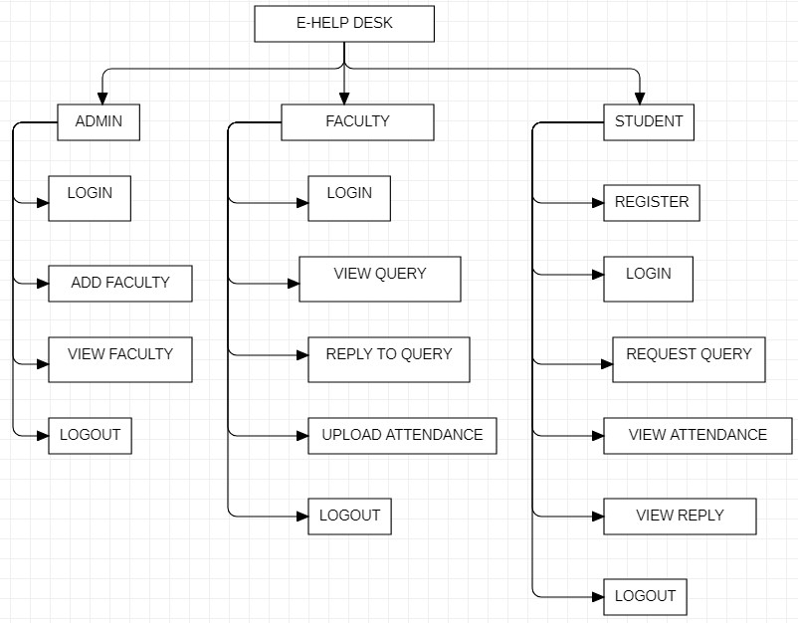
FRAMEWORK OF E-HELP DESK:

Slide 8
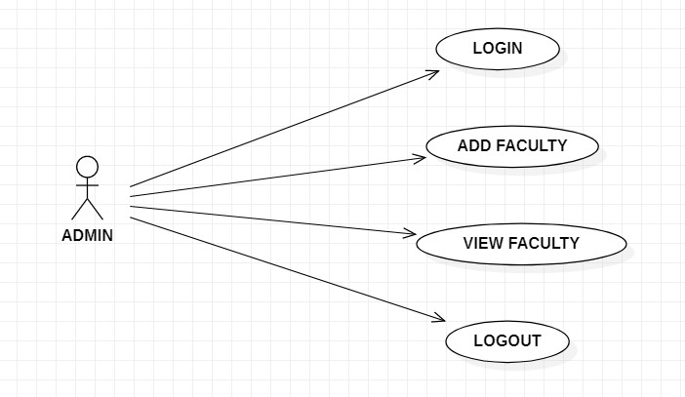
USE CASE DIAGRAM FOR ADMIN:

Slide 9
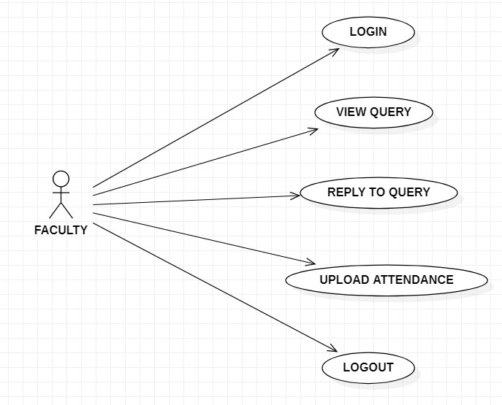
USE CASE DIAGRAM FOR FACULTY:

Slide 10
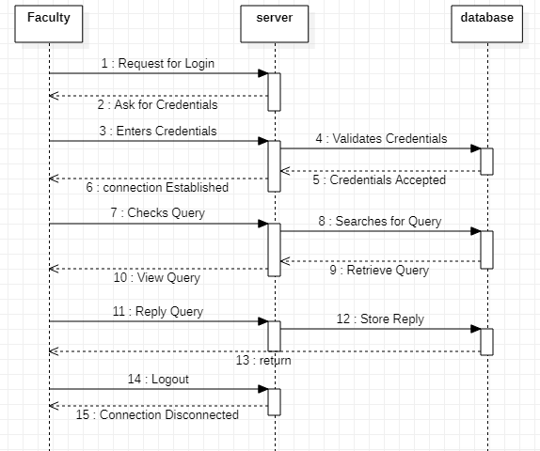
SEQUENTIAL DIAGRAM FOR FACULTY:

Slide 11
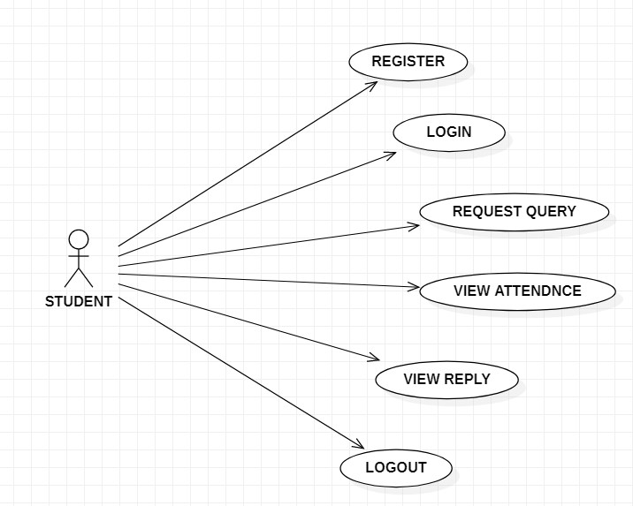
USE CASE DIAGRAM FOR STUDENT:

Slide 12
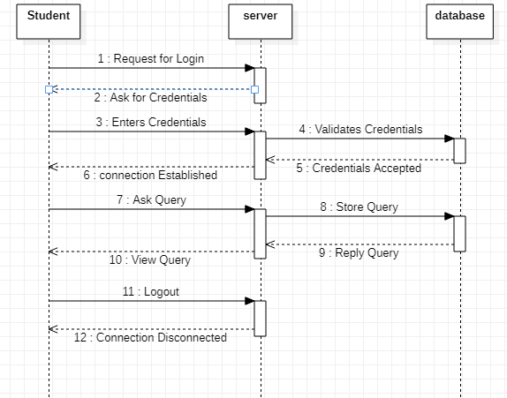
SEQUENTIAL DIAGRAM FOR STUDENT:

Slide 13
CONTRIBUTION:
Siddharth:
Information gathering
Styling of Website
Hari Kishore:
Designing and Development of Frontend.
Nithin:
Developing server and database management.

Slide 14
CONCLUSION:
The Student Helpdesk project is the small step to reduce the communication distance between the staff and the students.
As the growing use of computers the other electronic devices would mean the growing demand on rapid and quick technical support ,this Help Desk support system is carefully designed to fit with the rapid technical support .
Student Helpdesk is designed to accommodate future upgrading and development without need for building a new system to fit with the growing needs and demands of the system.

Slide 15
FUTURE ENHANCEMENTS:
This project can be extended by allowing students to access marks ,profile , attendance details, materials from one convenient location , using a single user id and password.
This also involves adding user experience and security features by using Authentication and Authorization.

Slide 16
THANK YOU !!

